Slide 1
Smart Car Data Logger

Slide 2
Project details
The system is equipped with a GPS module which will be providing the exact location of the car (accurate upto 2.5 meters), speed and also with the timestamp of the accident. For providing us the acceleration and the orientation of the car, ADIS16490 sensor is installed. A wide array of sensors will be available to provide us with the surrounding parameters of both inside and outside the car. Thd DHT22 moisture sensor will be available to check for fog or rainy conditions. A total of 3 LDRs will be installed, one on the roof add 2 near each headlights. The roof one will check for the visibility and the other two will note down the working conditions of the headlights. An ultrasonic distance sensor will be installed in the front to navigate through the fog and also record the data of any object that was hit by the car. Three gas sensors will be present inside the car – MQ3 to check for the alcohol level, MQ7 to check if there's any Carbon Monoxide leak and finally the MQ135 to map the Air Quality inside the car. The data from all the sensor modules will be processed by Arduino Mega 2560 microcontroller and will be stored on a SD card and can be transmitted in real time via the Bluetooth module.

Slide 3
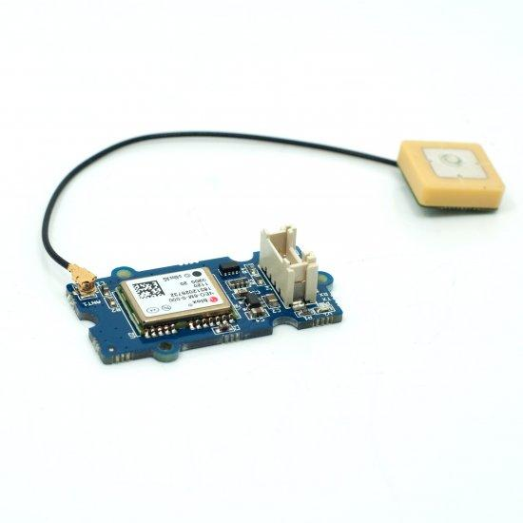
GPS Sensor Trade and Selection
COMPONENT | INTERFACE | RESOLUTION (m) | HOT START TIME (s) | COLD START TIME (s) | WEIGHT (g) | COST (INR)
UBLOX NEO 6M | I2C/SPI/UART/ USB | 2.5 | 1 | 38 | 12 | 350
GROOVE GPS MODULE | UART | 2.5 | <1 | 13 | 17 | 1707
ADAFRUIT ULTIMATE BREAKOUT | I2C/UART | <3 | 34 | 34 | 8.5 | 2906
Selected – Groove GPS Module
Less Cold start time and moderate cost

Slide 4
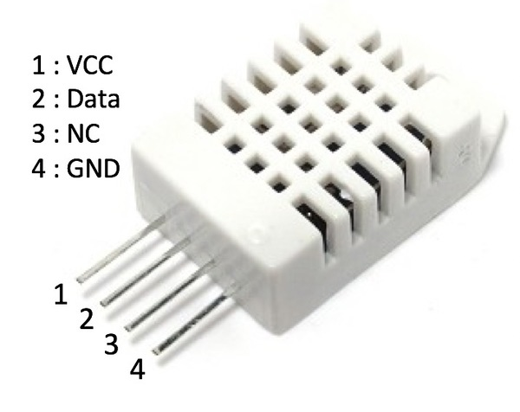
Moisture Sensor
Trade and Selection
Model | Current drawn (mA) | Voltage (V) | Temperature Range | Humidity Range | Body Size | Sampling Rate
DHT 22 | 2.5 | 3 to 5V | -40 to 80°C ±0.5°C | 0-100% 2-5% accuracy | 15.1mm x 25mm x 7.7mm | 0.5 Hz
DHT 11 | 2.5 | 3 to 5V | 0-50°C ±2°C | 20-80% 5% accuracy | 15.5mm x 12mm x 5.5mm | 1 Hz
Selected – DHT 22
Higher humidity and temperature range with more accuracy

Slide 5
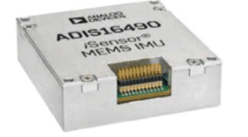
Acceleration and Gyro sensor Trade and Selection
Model | Dynamic range | in-run bias stability | Accelerometer range | Angular random walk | Operating temp range | Operating voltage
ADIS16490 | ±100°/sec | 1.8°/hr | ±8 g | 0.09°/√hr | −40°C to +105°C | 3.0 V to 3.6 V
ADIS16485 | ±450°/sec | 6°/hr | ±5 g | 0.3°/√hr | −40°C to +105°C | 3.0 V to 3.6 V
ADIS16488A | ±450°/sec | 5.1°/hr | ±18 g | 0.26°/√hr | −55°C to +105°C | 3.0 V to 3.6 V
ADIS16490 is selected as it has sufficient dynamic range and accelerometer range, and higher stability
All the sensors have SPI interface

Slide 6
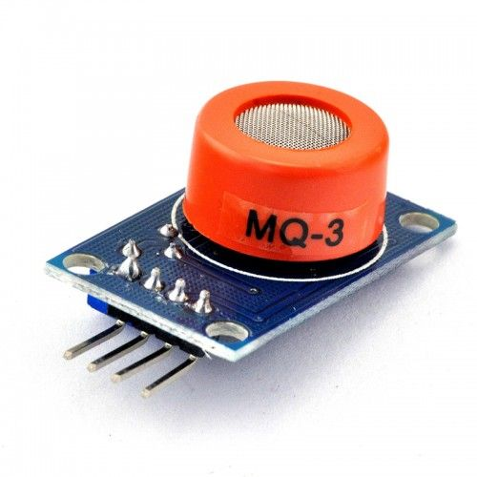
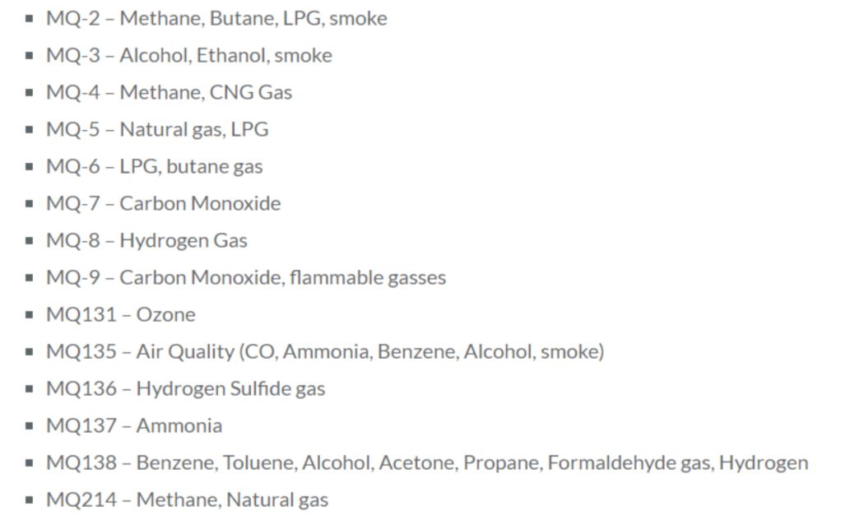
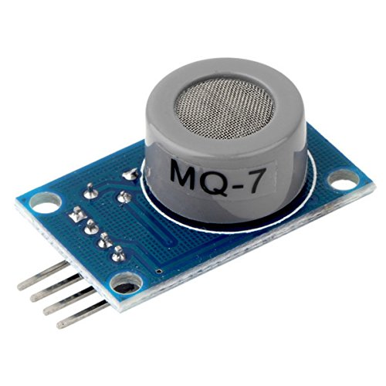
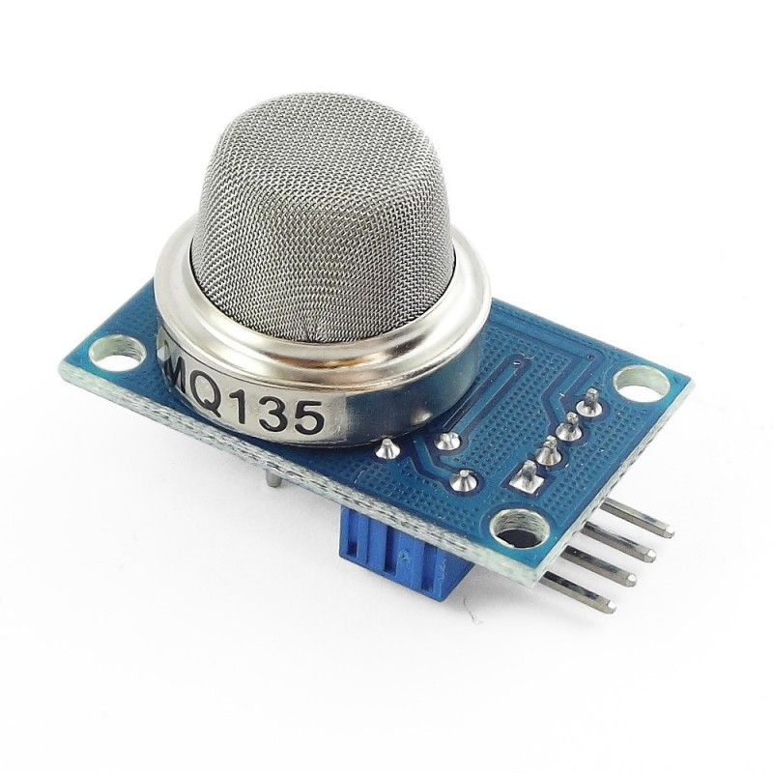
Selected Sensors : MQ-3 for alcohol levels
MQ-7 for Carbon Monoxide level
MQ-135 for Air Quality index

Slide 7
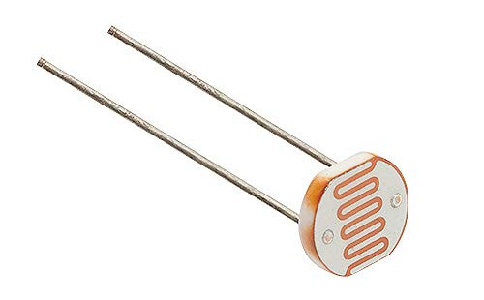
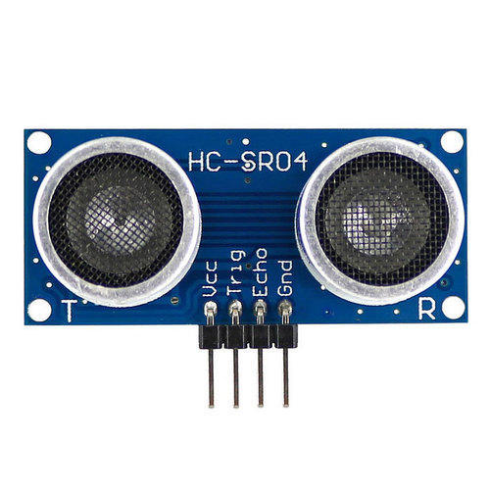
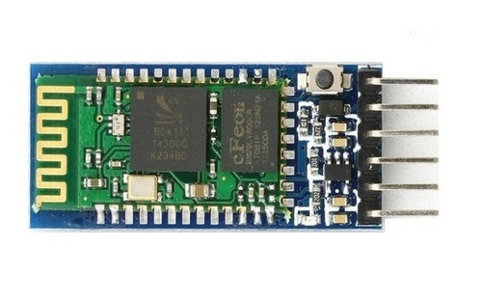
Light Detection Sensor :- Light dependent resistor (LDR)
To check the visibility and the working conditions of headlights
Distance Sensor :- Ultrasonic Sensor (HC – SR04)
Useful for navigating in fog conditions and the data stored can also be used to check if the car was hit before the accident.
Bluetooth Module :- HC-05

Slide 8
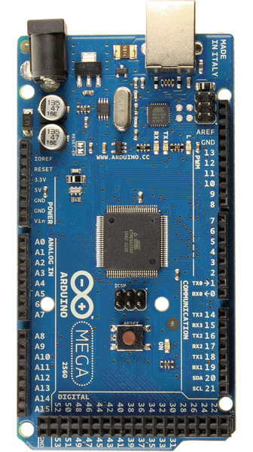
Arduino Mega 2560
A total of 10 analog pins are required for the circuit plus . Arduino UNO has only 6 pins available.
The ATmega328P on the UNO does not have sufficient flash memory.
Hence the Arduino Mega 2560 becomes the ideal choice here with a large memory space and more number of pins.

Slide 9
Component | Voltage (V) | Current (mA) | Power (mW)
Arduino Mega | 5 | 42 | 210
DHT 22 | 5 | 2 | 10
LED | 5 | 15 | 75
LDR (x3) | 5 | 0.5 | 2.5x3=7.5
MQ 135 | 5 | 150 | 750
MQ 7 | 5 | 150 | 750
MQ 3 | 5 | 150 | 750
HC-SR04 | 5 | 6 | 30
ASID16490 | 3.3 | 89 | 293.7
SD card | 3.3 | 5-40 | 132(max)
Bluetooth | 3.3 | 40 | 132
GPS | 3.3 | 40 | 132

Slide 10
Power Supply
GPS
Bluetooth
SD Card
ASID16490
5V
regulator
Arduino Mega 2560
DHT 22
Ultrasonic
3.3 V
Switch
(ON/OFF)
5 V
5 V
5 V
LDR
LED
MQ 3
MQ 135
MQ 7

Slide 11
ASID16490
SD Card
Bluetooth
SPI
UART
Arduino Mega 2560
UART
GPS
Power
Source
DIGITAL
DHT 22
ANALOG
LED
MQ 3
MQ 7
MQ 135
LDR
Ultrasonic

Slide 12
Start
Sensor read configuration in SD card
Clear data in SD card
Send data to server
Read data in SD card
If there is an update config
Write new configuration in SD card
Sensor get data and store in SD card
If sensor read interval
Sensor get data and store in SD card
If there is an emergency situation
If transmitting time

